Slide 1
ABC Call Volume Trend Analysis

Slide 2
PROJECT DESCRIPTION
The project aims to analyze the factors influencing call volume trends and customer service efficiency, with success defined by improved response rates and reduced abandoned calls.
The analysis will explore correlations between call queue time, call duration, agent availability, and customer call patterns to identify trends and optimize resource allocation.
Data cleaning and preprocessing will be a crucial step to handle missing values, remove duplicates, and identify outliers.
The goal is to find key insights that can help improve manpower planning, enhance customer experience, and optimize call center operations.

Slide 3
TECH STACK USED
SOFTWARE:
EXCEL:
Excel is a powerful spreadsheet software used for data analysis, calculations, and visualization.
It allows users to create the table, charts, and graphs to organize and present data.
Excel has formulas, functions
It is widely used in finance, business, research, and education for managing large datasets for predicting the useful insights.

Slide 4
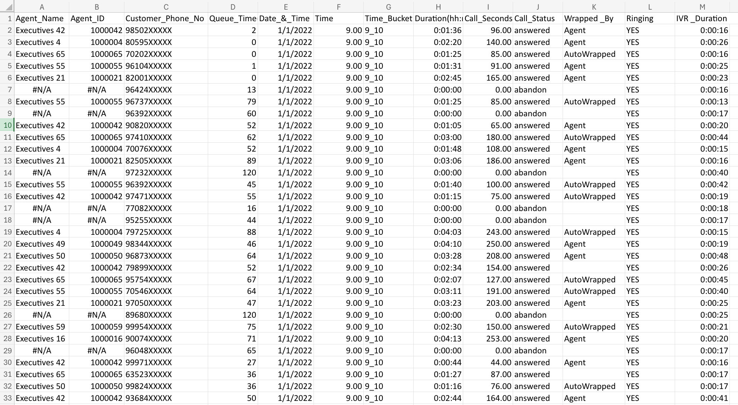
RAW DATA:
13 columns and 1,17,989 records

Slide 5
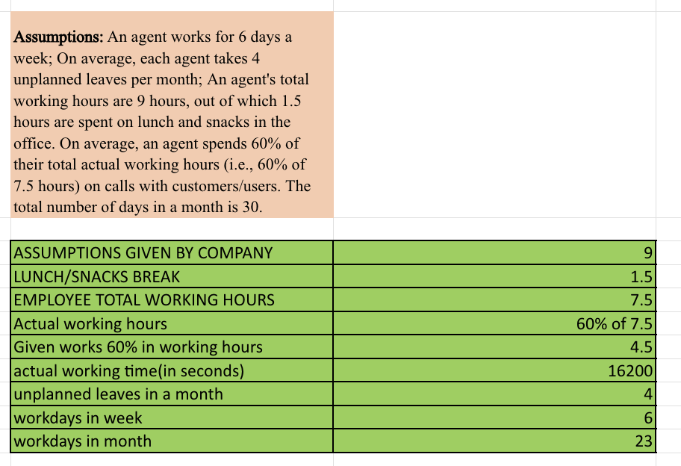
ASSUMPTIONS GIVEN:

Slide 6
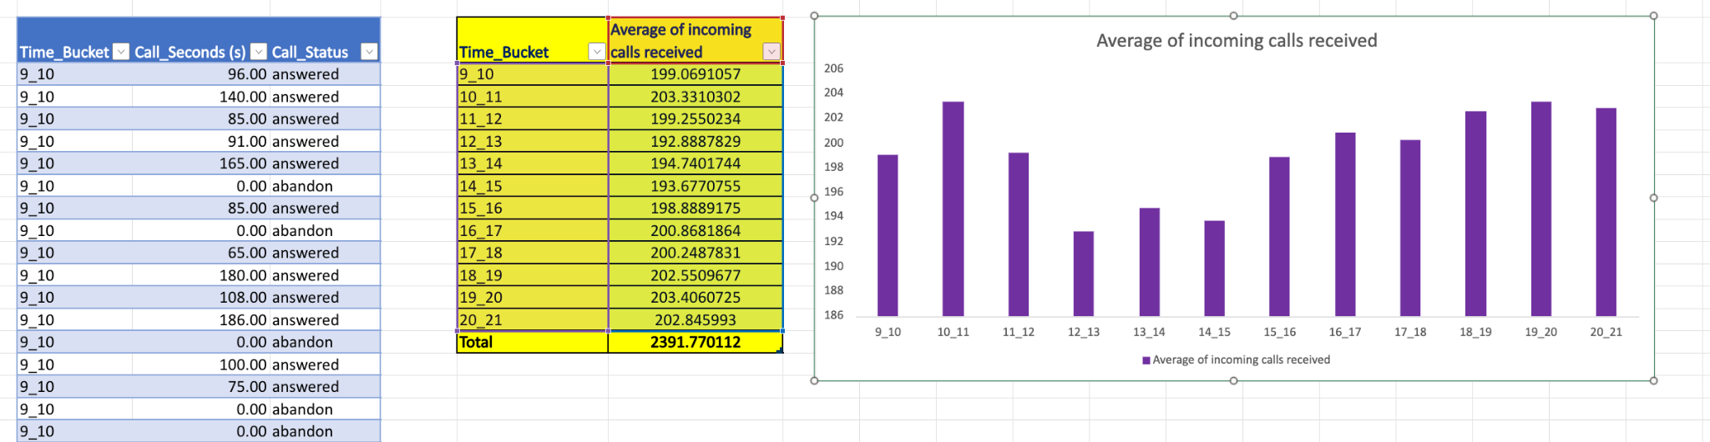
Data Analytics Tasks
1.Average Call Duration: Determine the average duration of all incoming calls received by agents. This should be calculated for each time bucket.
Your Task: What is the average duration of calls for each time bucket?
FORMULA USED : =AVERAGEIFS(Table2[Call_Seconds(s)],Table2[Time_Bucket],F3,Table2[Call_Status],"answered")

Slide 7
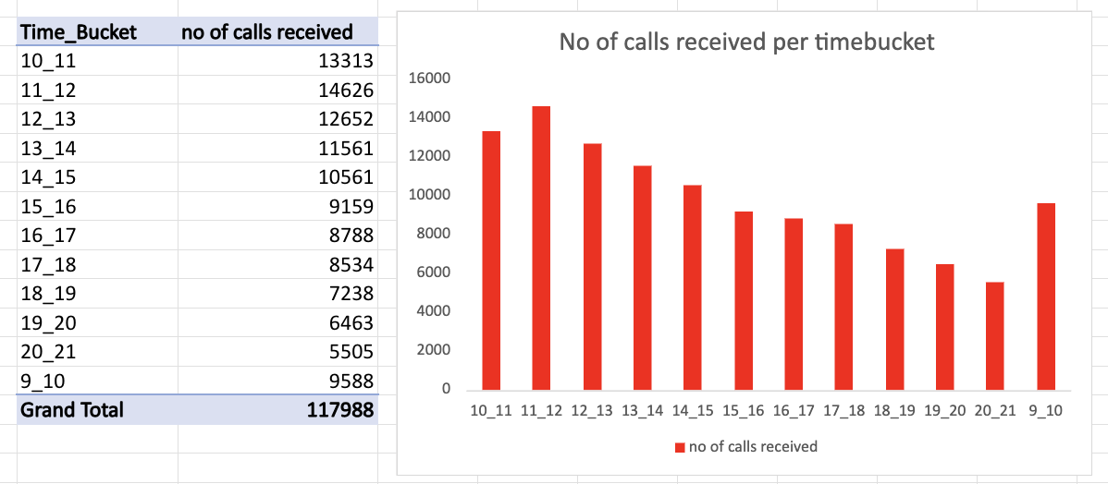
Data Analytics Tasks
2.Call Volume Analysis: Visualize the total number of calls received. This should be represented as a graph or chart showing the number of calls against time. Time should be represented in buckets (e.g., 1-2, 2-3, etc.).
Your Task: Can you create a chart or graph that shows the number of calls received in each time bucket?

Slide 8
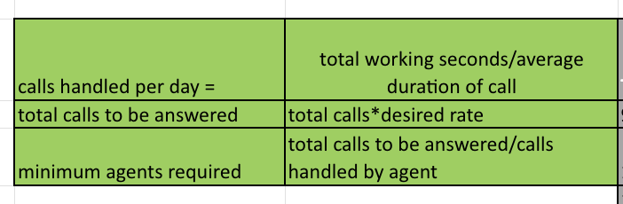
Data Analytics Tasks
3.Manpower Planning: The current rate of abandoned calls is approximately 30%. Propose a plan for manpower allocation during each time bucket (from 9 am to 9 pm) to reduce the abandon rate to 10%. In other words, you need to calculate the minimum number of agents required in each time bucket to ensure that at least 90 out of 100 calls are answered.
Your Task: What is the minimum number of agents required in each time bucket to reduce the abandon rate to 10%?
Formulas used:

Slide 9
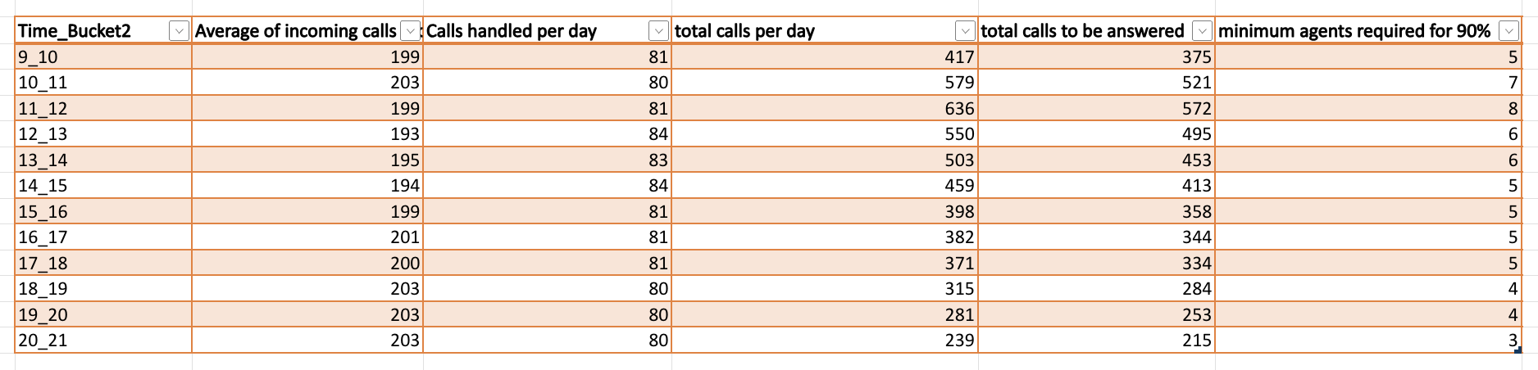
Data Analytics Tasks
3.Manpower Planning:

Slide 10
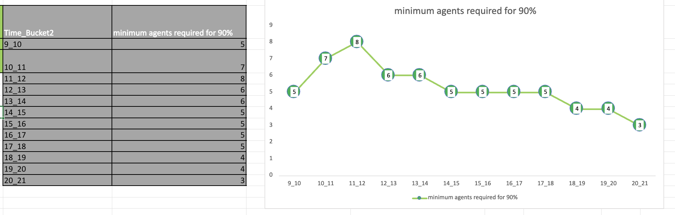
Data Analytics Tasks
3.Manpower Planning:

Slide 11
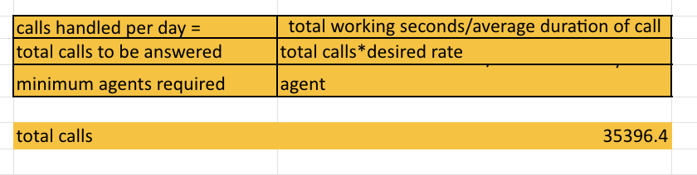
Data Analytics Tasks
4.Night Shift Manpower Planning: Customers also call ABC Insurance Company at night but don't get an answer because there are no agents available. This creates a poor customer experience. Assume that for every 100 calls that customers make between 9 am and 9 pm, they also make 30 calls at night between 9 pm and 9 am. The distribution of these 30 calls is as follows:
Your Task: Propose a manpower plan for each time bucket throughout the day, keeping the maximum abandon rate at 10%.

Slide 12
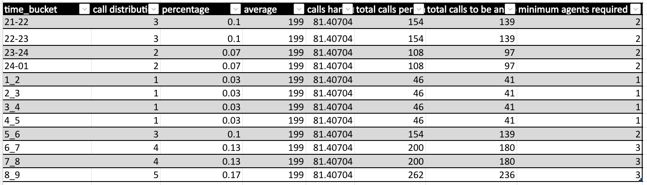
Data Analytics Tasks
4.Night Shift Manpower Planning:

Slide 13
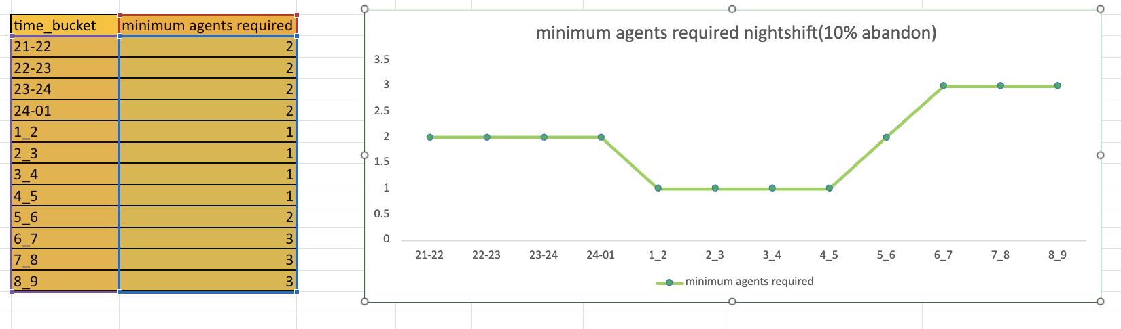
Data Analytics Tasks
4.Night Shift Manpower Planning:

Slide 14
INSIGHTS
A. Average Call Duration Analysis: Found out how long calls typically last in each time slot to understand agent workload and customer interaction time.
B. Call Volume Analysis: Created visualizations to see when the most calls come in, helping identify peak hours and quieter periods.
C. Manpower Planning: Figured out how many agents are needed in each time slot to bring down the abandoned call rate from 30% to 10%.
D. Night Shift Manpower Planning: Looked at the number of calls coming in at night and suggested a staffing plan to ensure customers get support with minimal wait times.

Slide 15
CONCLUSION
Excel is a great tool for data analysis, making it easy to clean, organize, and visualize large datasets.
Features like pivot tables, charts, and built-in functions help in quickly analyzing call trends and agent performance.
With formulas and automation, complex workforce planning and call volume analysis become more efficient and accurate.
This project helped in understanding call patterns, agent workload, and key factors that influence customer experience and service efficiency.
Reference link:
ABC-CALL-VOLUME_EXCEL

Slide 16
Thank you

